Slide 1


RISC-V Coherence TileLink and OmniXtend: the path forward
March 2021

Slide 2






Western Digital Proposes Open Standard Interface for Memory Fabric—OmniXtendTM
RISC-V
GPU
FPGA
Memory
AI Accelerator
Other CPU
Memory Fabric
Data is the center of the architecture
No established hierarchy—CPU doesn’t ‘own’ the GPU or the Memory
Cache coherency is preserved over the Network

Slide 3
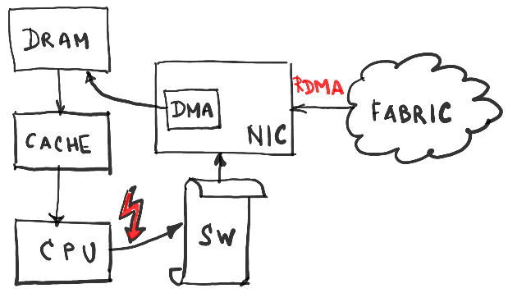
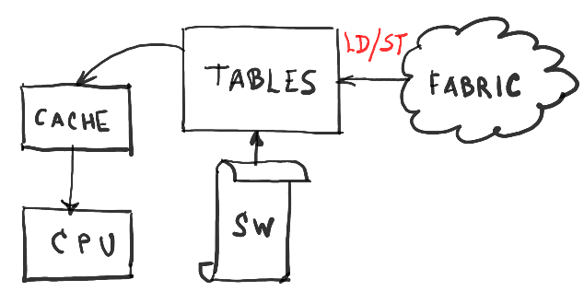
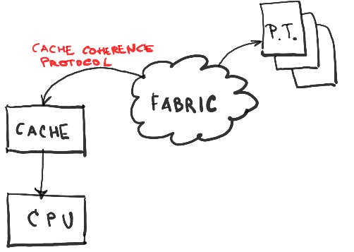
OmniXtend vs. other memory-centric concepts
Memory fabric may mean different things to different people:
Page fault trap leading to RDMA request (incurs context switch and SW overhead)
Global address translation management in SW, leading to LD/ST across global memory fabric
Coherence protocol scaled out, global page management and no context switching
Context switch cost comparable to memory access latency
Require software/kernel support and/or rewriting of applications
This is OmniXtend
No rewriting of software, scalable like the algorithm

Slide 4


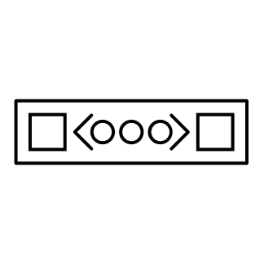
OmniXtend enables various architectures
Point to Point
Through an Ethernet Switch
Cache controller
Cache controller
Cache controller
Cache controller
Uncore
Cache controller
Cache controller
Cache controller
Cache controller
CC-S
CC-S
Gen5 PCIe OpenCAPI
Cache controller
Cache controller
Cache controller
Cache controller
Cache controller
Cache controller
PCM/MRAM
NVDIMM-P DDR
CC-HA
RA
Cache controller
Cache controller
DRAM
Uncore
Uncore
CC-S
802.3 Phy
Gen5 PCIe OpenCAPI
CC-S
CC-S
CC-S
CC-S
Gen5 PCIe OpenCAPI
Uncore
CC-S
CC-S
RA
CC-HA
NVDIMM-P DDR
NVDIMM-P DDR
CC-HA
RA
Gen5 PCIe OpenCAPI
CC-S
CC-S
PCM/MRAM
RA
DRAM
DRAM
Cache controller
Cache controller
CC-S
PCM/MRAM
CC-S
CC-HA
NVDIMM-P DDR
DRAM
802.3 Phy
CC-S
CC-S
CC-S
CC-S
802.3 Phy
CC-S
PCM/MRAM
Cache controller
Cache controller
802.3 Phy
CC-S
CC-S
Cache controller
Cache controller
Cache controller
Cache controller
Cache controller
Cache controller
Cache controller
Cache controller
Cache controller
Cache controller
Cache controller
Cache controller
Program switch to replace ethernet protocol with OmniXtend protocol to handle memory coherency traffic
Cache controller
Cache controller
Cache controller
Cache controller
Tofino
Uncore
Programmable (P4) Switch
CC-S
CC-S
Gen5 PCIe OpenCAPI
PCM/MRAM
NVDIMM-P DDR
CC-HA
RA
DRAM
CC-S
CC-S
CC-S
802.3 Phy
NVM
Cache controller
Cache controller
802.3 Phy
NVM
Cache controller
Cache controller
NVM
802.3 Phy
802.3 Phy
NVM
ML Accelerator
NVM
NVM

Slide 5
OmniXtend v1.0.3 is a mature protocol
TileLink 1.8: well proven coherence, deployed in many chips in the field
OX v1 has completely different header format than v0.1
Eth L2 compliant header
Multiple messages per frame
Retransmission (can unplug/plug the cable in a running system)
2x TLoE serializers per chip (PCIe connected to L2$ without cycles in TL graph)
New FPGA binary works in test system
100 MHz U5, up from 50 MHz
VCU118 binary 4-hart SoC Published on github

Slide 6
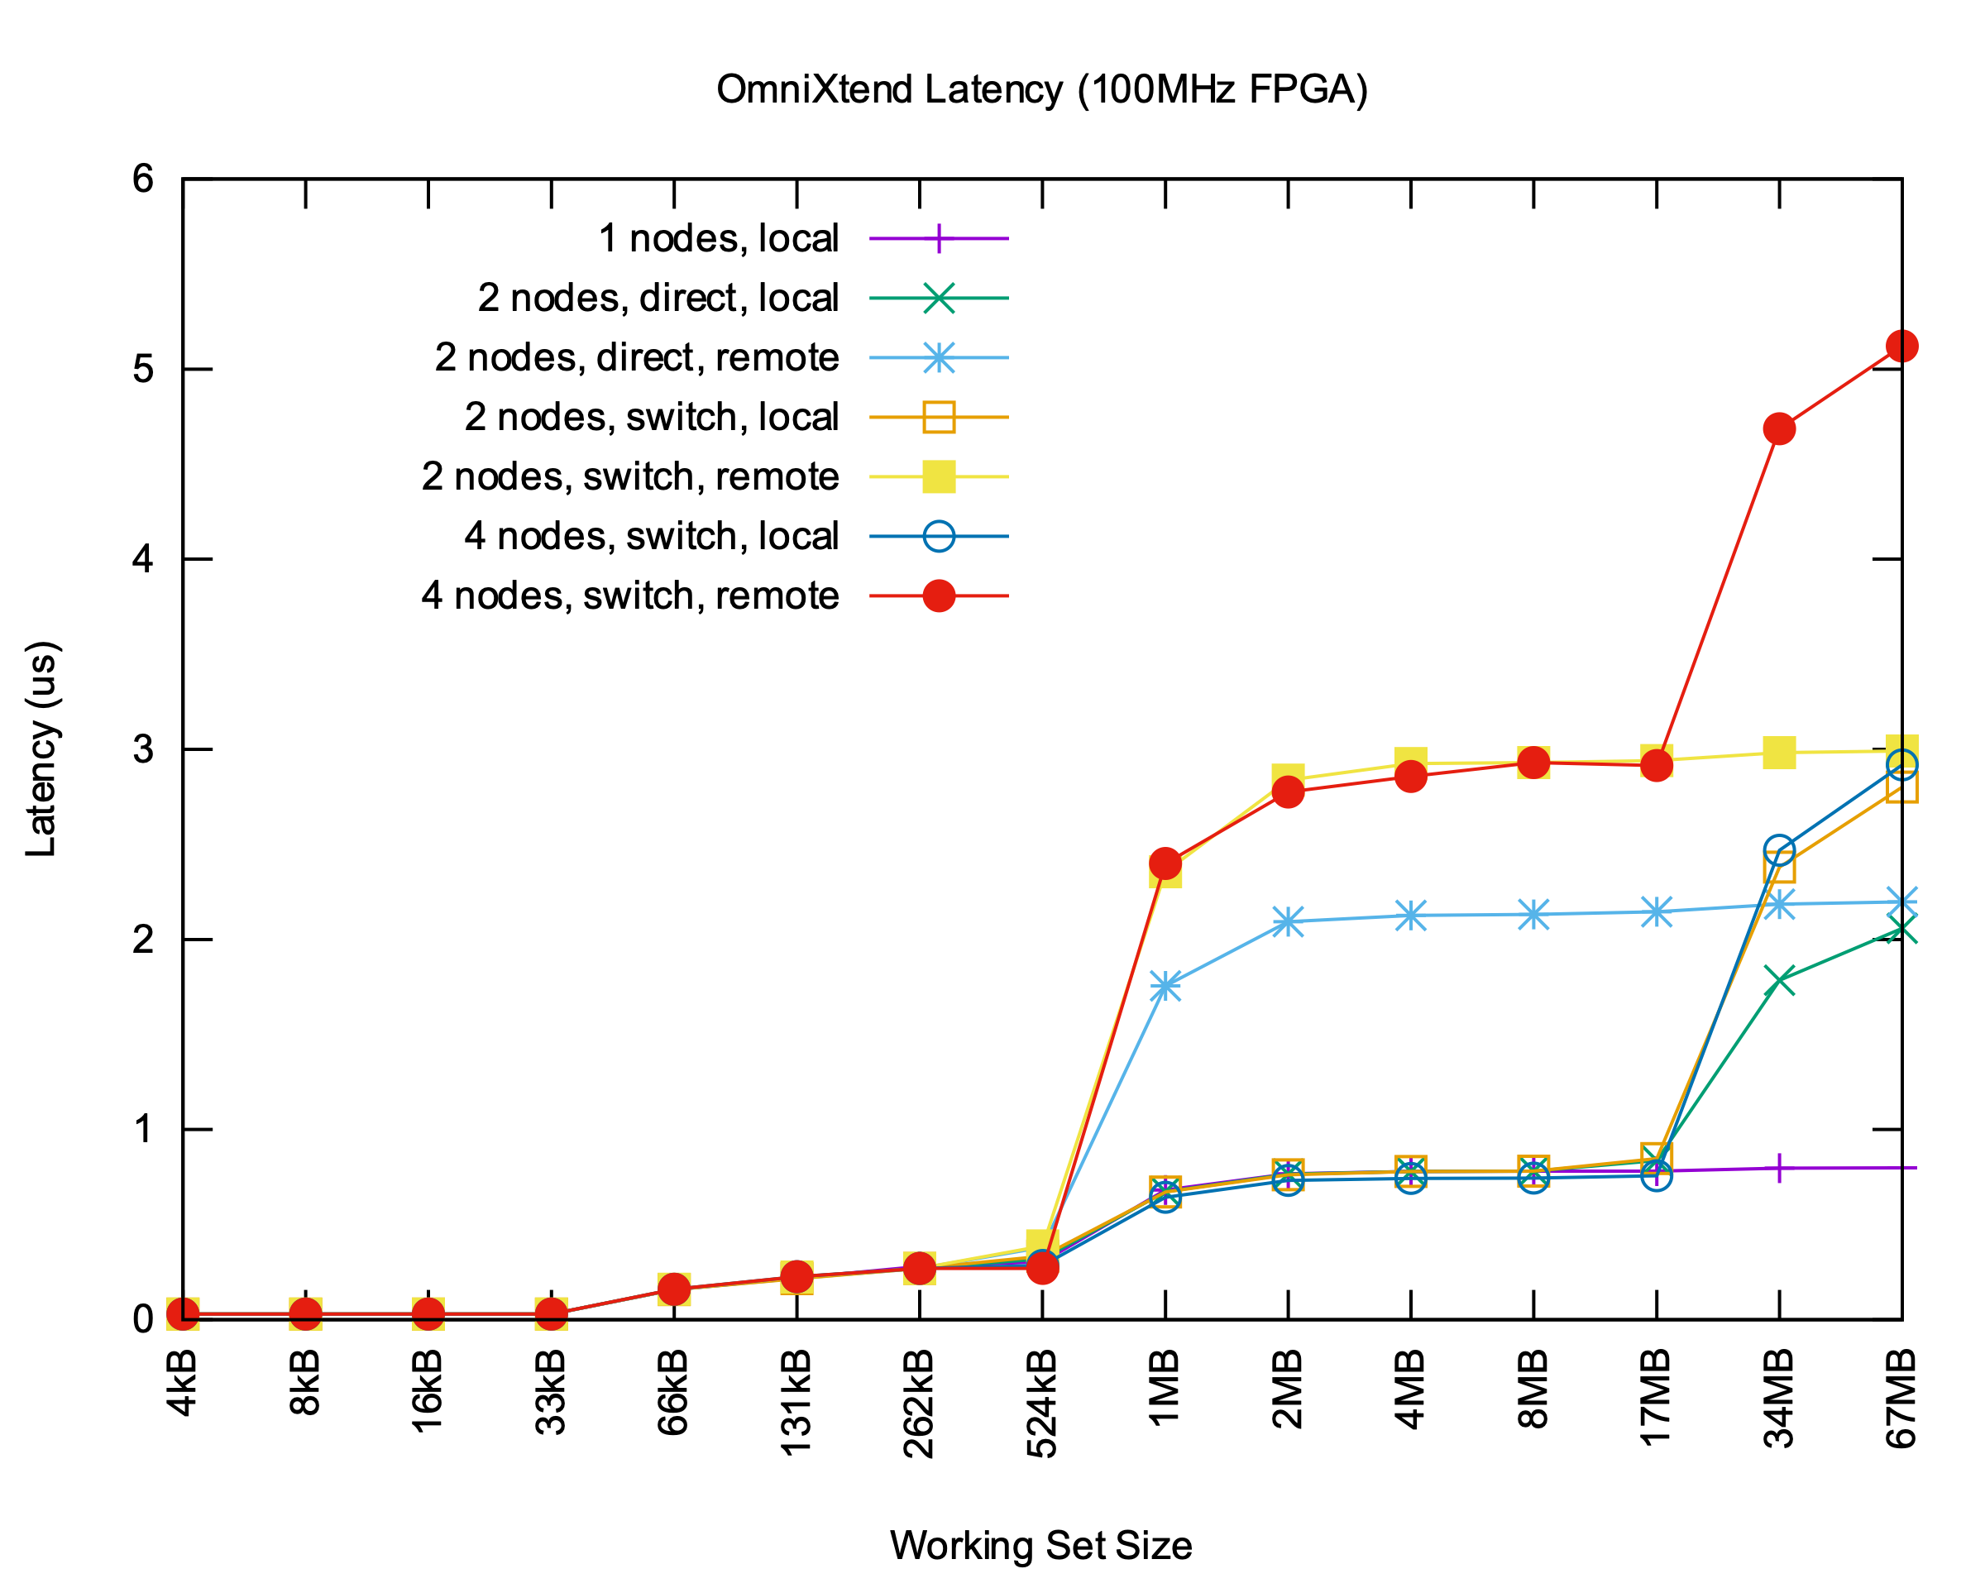
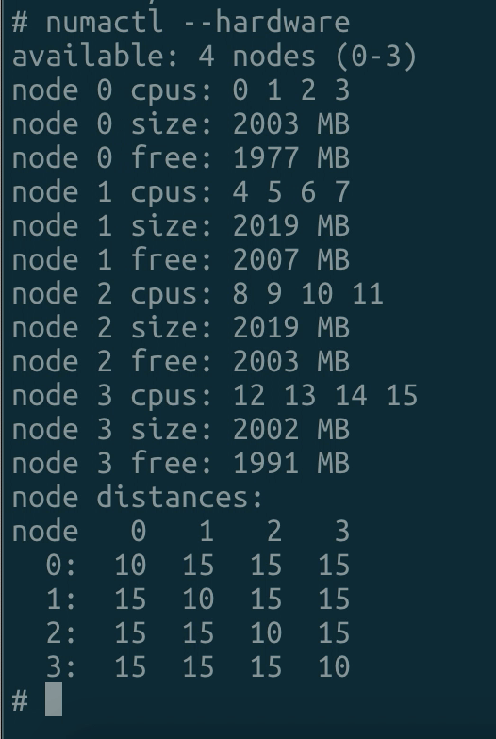
Current Status
Working NUMA setup
Up to 4 OmniXtend sockets with NUMA enabled
Dynamic topology reconfiguration with DIP switches
Point-to-Point cable, or via SN2010 switch
Based on latest upstream Linux kernel (v5.9)

Slide 7
Upcoming milestones with OmniXtend v1.0.3
Disaggregated memory controller
Lowest Point of Coherence example RTL, to be open-sourced by WDC
Storage device emulation with HBM
Storage device with flash
“Beyond Intel” architectures:
More than four sockets (boot protocol and configuration manager)
More than 64 sockets (multi-switch p4 programming and optimizations)
Independent OSes with coherent shared memory region
Heterogeneous Hardware/Software systems
VCU118 with qemu
RISC-V with non-RISC-V ISA, compute accelerators, coherent GPUs etc.
Baked in silicon

Slide 8
TileLink/OmniXtend 2.0 discussions
Current focus is on scaleout and fault-tolerance
as opposed to raw benchmark performance (i.e. forwarding, more states)
Independent OS model
Communicating node loss to user process
Scaleout considerations
Reconsidering the ability of “smart” switches to terminate the protocol
Storing state in memory
Dealing with non-random-access memories
Dealing with memories that wear out with use

Slide 10
Single OS (SO) Model
Similar to a regular SMP/NUMA system
System
memory0
memory1
CPU0
CPU1
CPU2
CPU3
CPU4
CPU5
CPU6
CPU7
NUMA node 0
NUMA node 1
Node 0
OmniXtend fabric
Node 1
memory0
memory1
CPU0
CPU1
CPU2
CPU3
CPU0
CPU1
CPU2
CPU3
Notes:
Single OS (SO)
All nodes together behave as a single SMP machine
All memory is shared and visible by any CPU from any node
NUMA node representation of CPUs and memory
Standard method to build a system with few nodes
May not scale beyond that

Slide 11
Independent Nodes (IN) Model
Experimental approach that can scale
shared memory
Node 0
Node 1
memory0
memory1
CPU0
CPU1
CPU2
CPU3
CPU0
CPU1
CPU2
CPU3
OmniXtend fabric
Each node boots independent instance of Linux
Access shared memory exposed by a kernel driver

Slide 12
What is system emulation?
Implement the entire OmniXtend protocol in Qemu
An OmniXtend system consists of distributed compute, memory, storage and optional accelerator nodes
Nodes are connected to a traditional switch or programmable switch with enhanced features
OmniXtend Node 0
OmniXtend Node 1
Qemu emulation
Qemu emulation
kernel
phy
phy
kernel
ML Accelerator
Switch
OmniXtend Node 2
phy
FPGA/ASIC
NVM
NVM
NVM
phy
phy
Notes:
QEMU is a generic and open source machine emulator and virtualizer

